Slide 1

Exploratory Data Analysis
G2M insight for Cab Investment firm
17-Sep-2022

Slide 2
Agenda
Background
Data Preprocessing
EDA
EDA Summary
Hypothesis and Test
Recommendations and Insights

Slide 3
Background – G2M insight for Cab Investment firm
XYZ is a private equity firm in US. Due to remarkable growth in the Cab Industry in last few years and multiple key players in the market, it is planning for an investment in Cab industry.
Objective: Provide actionable insights to help XYZ firm in identifying the right company (Yellow/ Pink Cab) for making investment.
Datasets:
4 individual data sets.
Time period of data is from 31/01/2016 to 31/12/2018.
Cab_Data.csv – this file includes details of transaction for 2 cab companies
Customer_ID.csv – this is a mapping table that contains a unique identifier which links the customer’s demographic details
Transaction_ID.csv – this is a mapping table that contains transaction to customer mapping and payment mode
City.csv – this file contains list of US cities, their population and number of cab users
Cab_Data.csv
Customer_ID.csv
Transaction_ID.csv
City.csv
Master data

Slide 4
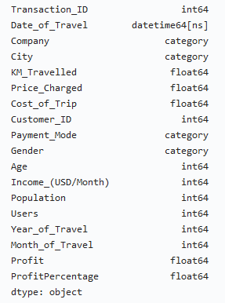
Data Preprocessing
Executive Summary
Create Master Data: Identify relationships across the 4 files
Replacing spaces with '_' in column names
Convert the 'Date of Travel' column into datetime standard format
Add column of 'Profit’ = Price_Charged - Cost_of_Trip
Removing ',' in population and users column values
Convert some columns from object to category

Slide 5
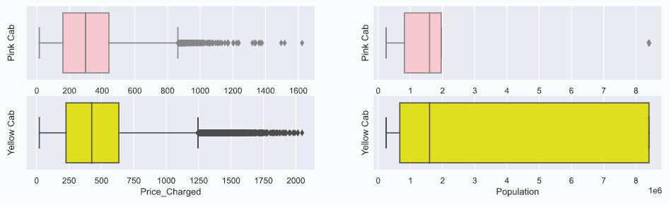
EDA
Data Check
There are no missing values.
There are no duplicated rows.
Price_Charged and Population have outliers (statistically). Considering lack of further background information, so keep the data at this stage.

Slide 6
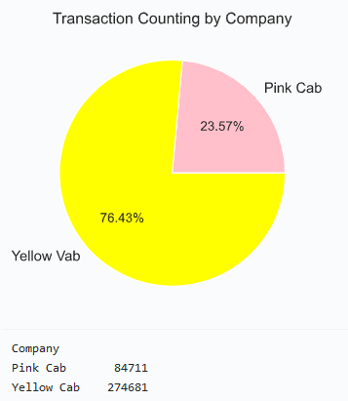
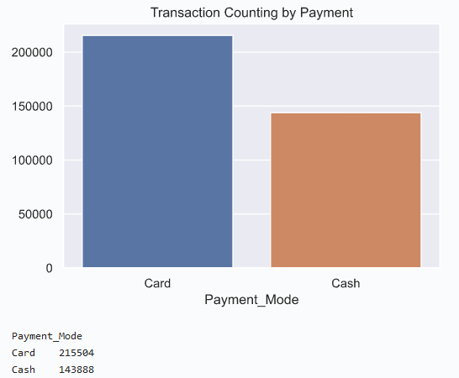
EDA
Categorical variables
Company: Yellow Cab is used more than Pink Cab. 76.4% of the transactions are from Yellow Cab, approximately 3 times that of Pink Cab.
Payment: Num of transactions paid by Card is 1.5 times num of those paid by cash.

Slide 7
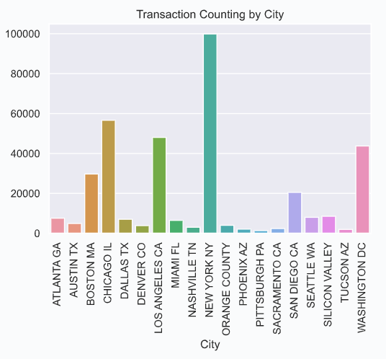
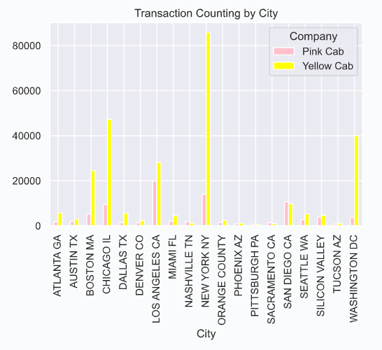
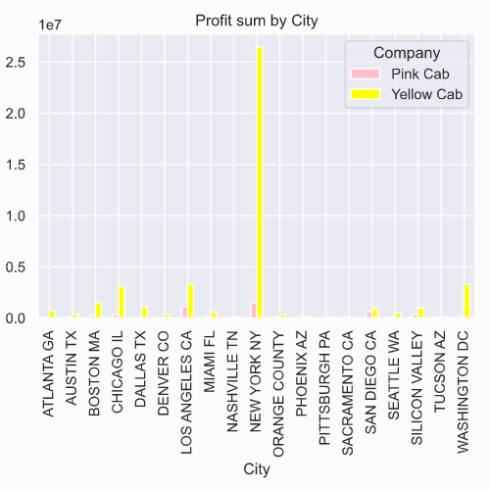
EDA
Categorical variables
City: NEW YORK NY has the most transactions while PITTSBURGH PA with least.
For Pink Cab: LOS ANGELES CA has the most transactions, followed by NEW YORK NY, SAN DIEGO CA. For
Yellow Cab: NEW YORK NY has the most transactions, followed by CHICAGO IL, WASHINGTON DC.
Especially in New York, Yellow Cab’s profit is extremely higher than Pink Cab.

Slide 8
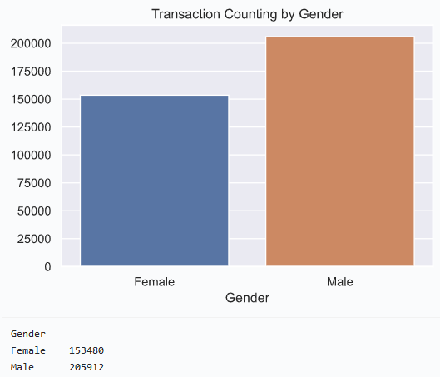
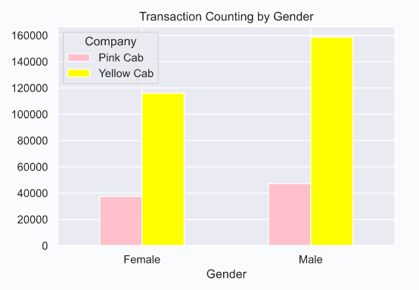
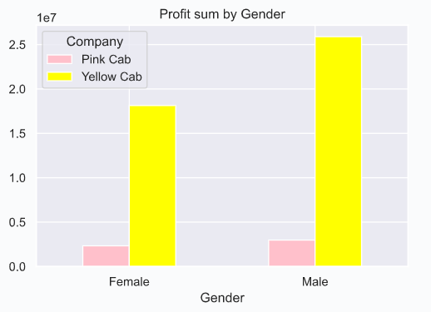
EDA
Categorical variables
Gender: Male use cab more frequently than female.
Yellow Cab has bigger gap in gender difference than Pink Cab, but they both have more male users.
Looks there is more obvious gender difference in profit of Yellow Cab. Later wee can further raise hypothesis and test.

Slide 9
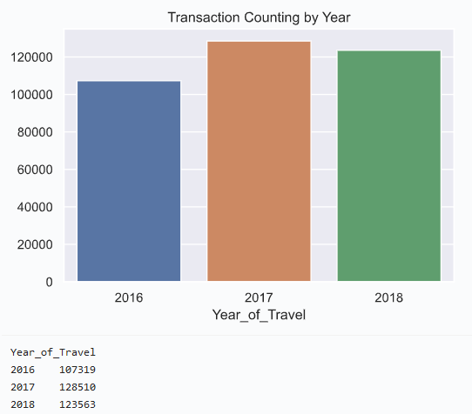
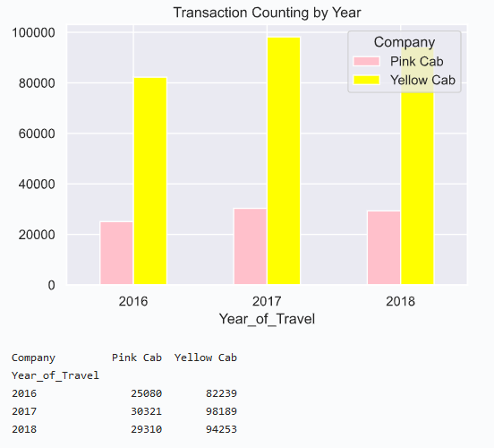
EDA
Numerical variables
Year: 2017 has the most transactions but the ‘Year’ column approximately has fairly distributed data.

Slide 10
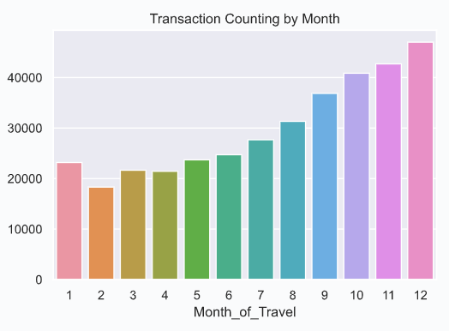
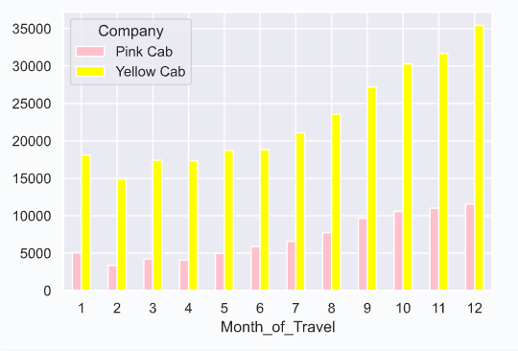
EDA
Numerical variables
Month: December has the most transactions while February with the least.
It can be said that transactions increase by month. No seasonality can be observed.
Same trends in both Pink Cab & Yellow Cab.

Slide 11
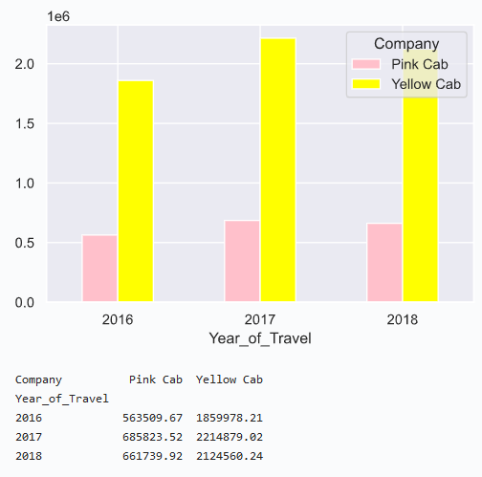
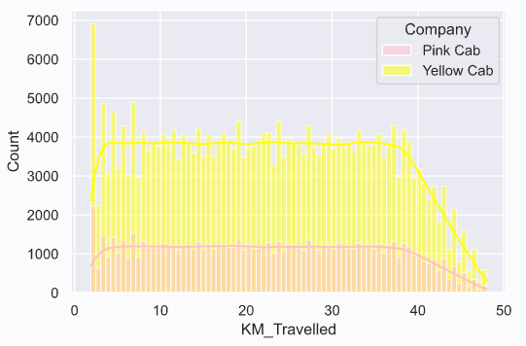
EDA
Numerical variables
KM_Travelled:
For both Pink Cab & Yellow Cab:
Most transactions travel 2~40 KM. The most transactions are short-distance travel.
2017 has the most KM_Travelled sum.

Slide 12
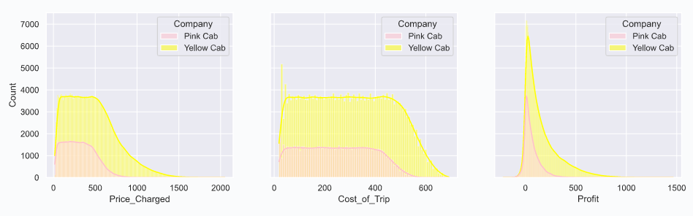
EDA
Numerical variables
Price_Charged, Cost_of_Trip, Profit: For both Pink Cab & Yellow Cab, Profit are not too high. Maybe since the most transactions are short-distance travel.

Slide 13
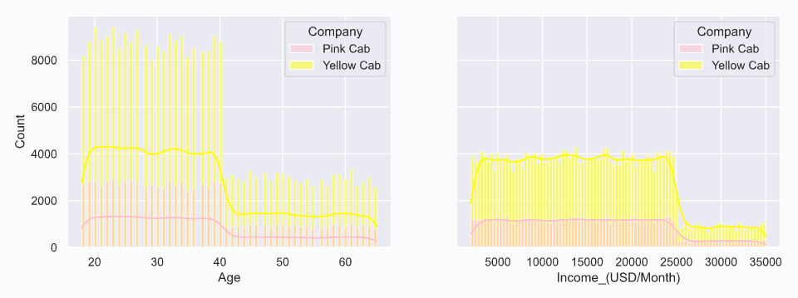
EDA
Numerical variables
Age, Income_(USD/Month):
People ages in the range of 18~40 use cab more frequently than those whose age is over 40.
People’s income in the range of 5000~25000 USD/Month use cab more frequently than those whose income is over 25000.

Slide 14
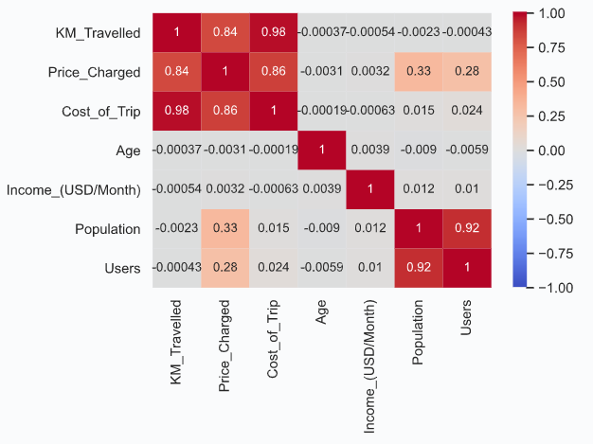
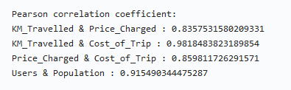
EDA
Correlation
There is strongly positive correlation between KM_Travelled & Price_Charged , KM_Travelled & Cost_of_Trip, Price_Charged & Cost_of_Trip, Users & Population.

Slide 15
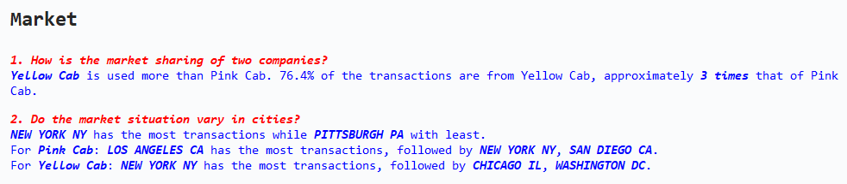
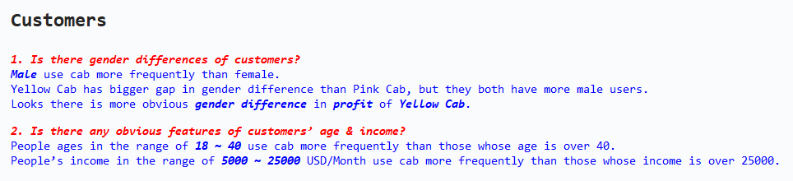
EDA Summary

Slide 16
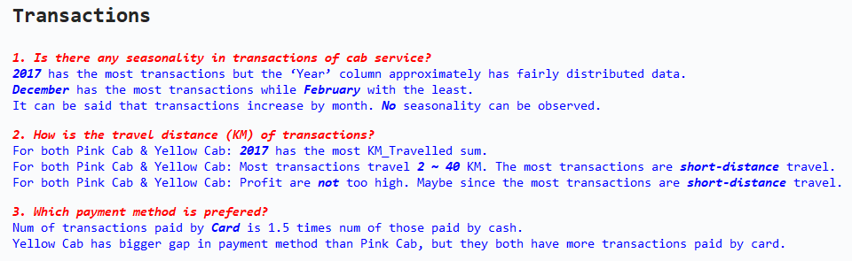
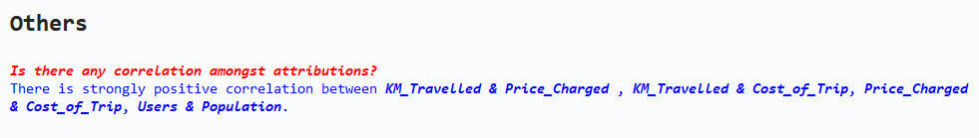
EDA Summary

Slide 17
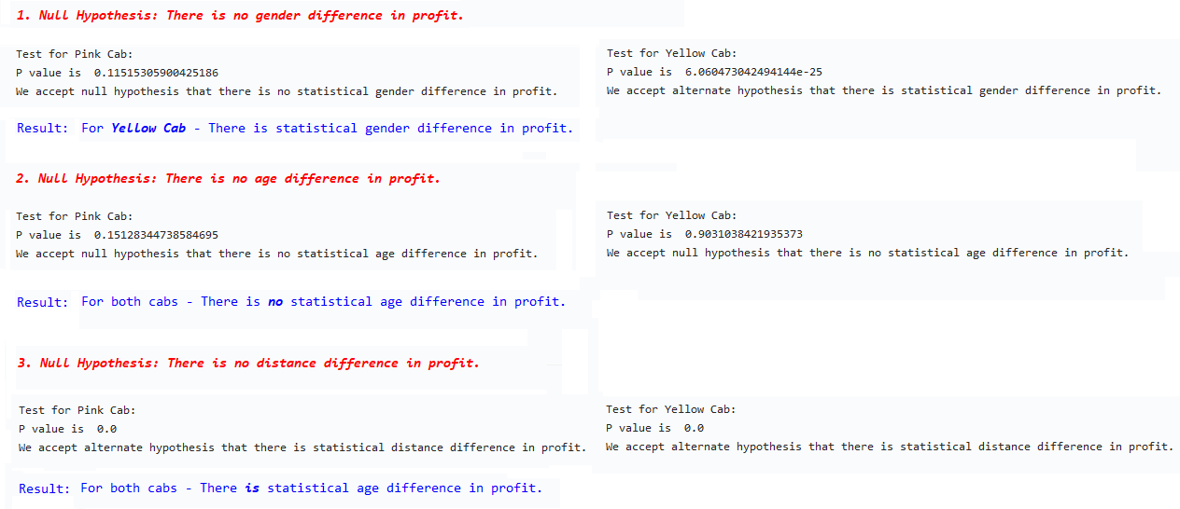
Hypothesis and Test

Slide 18
Recommendations and Insights
Briefly, based on the analysis, Yellow Cab is more worthy to make investment.
Yellow Cab is more popular and has more market sharing.
In many cities (especially New York, Washington, Chicago, Boston, Los Angeles, etc), Yellow Cab has overwhelming expansion advantage.
What’s more, in New York, Yellow Cab’s profit is extremely higher than Pink Cab.
Though target customers have similar features (age range: 18 to 40, income range: 5000 to 25000), Yellow Cab is more appeal to males and has higher profit gained from this group.
Though short-distance travel are the main market, Yellow Cab has the ability to deal with long-distance travel, which can directly lead to higher profit.

Slide 19
Thank You

